Slide 1


CTCARES for Child Care Businesses
An OEC Care Package to help with program expenses
Commissioner Beth Bye - June 19, 2020 & June 22, 2020

Slide 2


Our Ethos for Children & Families
Safe, High-Quality Programming for All
Accessible
Equitable and Inclusive
Evidence Based
Supportive
Responsive Customer Care
Respectful
Two-Way
Child and Family Centered

Slide 3

WHAT WE WILL DISCUSS TODAY
AGENDA
Business Reflections
ESF14 Recovery - Guiding Principles
Business Survey 1
CTCARES for Child Care Businesses and the CarePackage
Q&A

Slide 4
“I have very little income coming in and I am worried my program won’t survive.”
“ideas on disinfecting and keeping little ones from putting things in mouths and not sharing. Keeping children safe.”
“Gloves!”
“I don't understand much of that [applying for assistance], I'm afraid of having debts.”
“We stopped taking in tuition and we stopped paying teachers… If I could get a grant to pay them I would love it but I cannot afford a loan.”
“The current ECE business model isn’t designed for sustainability and the reality is that many child care centers will find it difficult, if not impossible, to re-open after the pandemic has subsided. We have a responsibility, as a field, to think ahead and use recovery grants, loans and TA to help address key structural issues.”
-Louise Stoney

Slide 5


ESF14 RECOVERY - GUIDING PRINCIPLES
Health and safety of children, families, staff, partners
Maintain and expand access to high quality programs
  Financial support to retain and stabilize programs
  Stabilize workforce
  Strengthen business health and quality of programs
  Build capacity (mindful of settings, ages, and gaps)
Continuity of care: same child / teacher / program
Partner to ensure all voices are represented
Overall operational simplicity

Slide 6
ABOUT BUSINESS SURVEY 1
Your input shaped this package – you were generous with your sharing and we deeply appreciate it.
The survey was open May 5-18, 2020
Licensed family child care homes, group homes, and centers (DCFH, DCGH, DCCC) and license exempt state funded programs emailed specific links to the survey.
Responses voluntary.
1,548 programs responded - 39% response rate
  (~42% of DCFHs and ~48% of DCCC/DCGHs).
Notes:
We’ve spoke with so many of you before, during, and since this survey – and all of you wanted to be sure your voices were heard. We can’t thank you enough for your input.

Slide 7
HOW YOU WILL SEE SURVEY DATA
OEC will share the full report and summary, and frequently reference survey data on our website. This data frames many conversations, decisions, requests... For example…

Slide 8
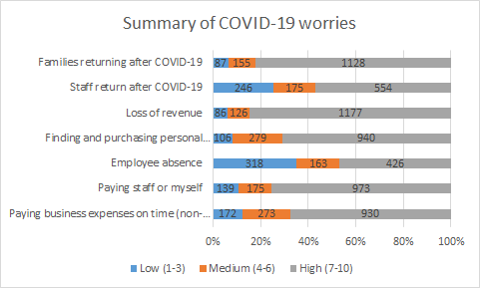
HOW WORRIED ARE YOU ABOUT…?
Notes:
We need to get a final slide of this with the %s

Slide 9
MOST PRESSING NEEDS GOVERNMENT CAN HELP YOU WITH?
Notes:
This was already a month ago.
Based on what we hear you saying, you want more help with these now more than ever.

Slide 10

PHASES AND LAYERS OF SUPPORT
Disaster recovery is immediate, short term, and long term.
Recovery has many phases and layers.
Initial phase supports:
  Unemployment benefits (regular, PUA, FPUC to end of July)
  Federal Head Start commitment
  OEC state funded program commitments (Care4Kids, School Readiness, Child Day Care contract, State Head Start)
  OEC’s CTCARES suite (Hospital Workers/Project 26, Frontline Workers, Child Care/Essential Workers, Family Child Care)
  Federal loans, grants, tax credits (including PPP, HEDCO, EIDL, COVID-19 medical leave cost reimbursement)
  Private loans and grants
Notes:
Only 324 programs applied for PPP and only 193 pf those reported their application being awarded
When asked why businesses didn’t apply for funds from any sources, respondents mentioned being uncomfortable taking a loan (even when they may be forgiven), not knowing about the funding programs, not qualifying, being overwhelmed, not having the necessary paperwork and not having a bank relationship as the top reasons.

Slide 11
NEED for Immediate Federal Support
Our fear is losing healthy, safe programs for children, families and staff.
Our need is a emergency federal funds for child care providers.
Our next steps help programs with expenses, knowing we can’t make programs whole.
Our work will continue – advocacy, listening, planning, responding.

Slide 12
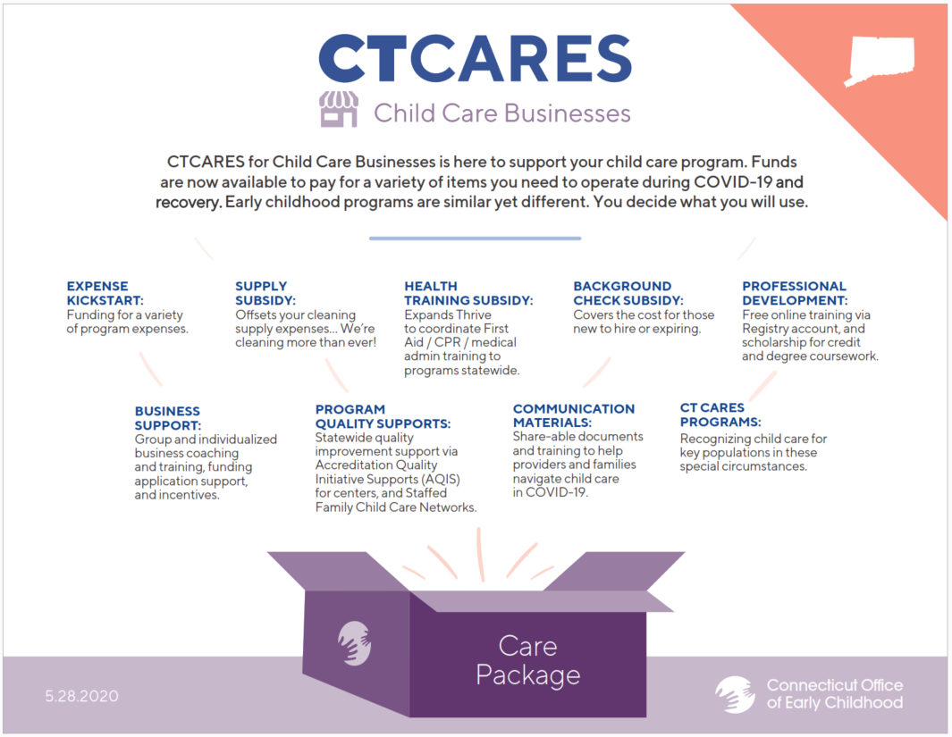
Notes:
Review each component
We heard your concerns in the survey and we continue to hear them in your calls and emails. Each of these supports is designed to lift some expense off your business and provide you free access to supports for a stronger program.
Expense Kickstart and Supply Subsidy – we’ll talk about those more in the next slides.
Health training subsidy: Early in COVID-19, OEC licensing announced recognizing certifications that expired during the emergency declaration. We heard your worry about catching up with expired certifications and paying for them. We will help you with required first aid / cpr / medication administration and emergency anaphylactic medication administration (EpiPen training) that expires during COVID-19. Our partner United Way of Connecticut will use the OEC’s Thrive platform to schedule trainings when training becomes safe again. Staff will work with programs around the state to schedule trainings in English and Spanish.
Background Check Subsidy: This adds funds to continue a support that previously ended – we will cover the cost for new hires and expirations so your business does not have to.
Professional Development: A reoccurring theme in the survey was the need for training about working in and after a pandemic. Watch for these free offerings to roll out over time. Webinars will be announced. Through your OEC Registry account you already have online training – and we are adding more health and safety specific content. You also can apply for scholarship through your OEC Registry account. Be sure to check the OEC Registry for details. A few important details about scholarship: the OEC recognized that many of you who had spring term awards could not finish your courses, and we are waiving our one-time payment per course policy to allow you to apply again for the same class this summer without penalty if we already paid for it. We are also working with staff that had been awarded spring term and are now laid off or furloughed but are still on track with your degree work. Please check with your OEC Registry regional education advisor for support.
Business Support: (refer back to slide of most pressing needs government can help with):Through the survey and with every call and email from all of you, we are reminded of how fragile our industry is. When the minimum wage went up to $11/hour, we heard how torn you were wanting to support better wages but not having additional income to pay a new salary schedule. Reduced demand for care – fewer families at your door – and trying to keep your doors open are huge challenges. We are partnering with Women’s Business Development Council to make sure our programs are strong and healthy BUSINESSES. We need our businesses to be ready to apply for funds, to file the right paperwork to have loans forgiven and taxes filed correctly, to apply for grants to grow and thrive. We need businesses of excellence to match the quality programming they offer. WBDC is the OEC’s statewide business support coordinator. We’re thrilled that programs have already been calling WBDC for free help and we’ll be announcing details about how to get longer term individualized support, access fiscal and technology incentives, and build business plans. We can’t let our children, families and staff – or ourselves – down by not ensuring we have stability and sustainability.
AQIS and SFCCNs: We hear your deep worries about what is happening for the children, and the questions you ask about what quality looks like now. Children are the reason we are here and we will make sure we continue to problem solve with you to deliver the highest quality possible. Watch for more detail to come about how to access free individualized and group supports, and keep NAFCC and NAEYC Accreditation standards in mind as you move forward with continuous quality improvement. We know best practices… Need a little help to figure out next steps during COVID-19 and after? These are the support projects to make that happen.
Communication Materials: You asked us to help you talk to staff, to children, to families. The ct.gov/coronavirus website has brochures for business opening and you may be seeing messaging campaigns on TV and social media now. The OEC also has the super helpful booklet: Guidance for Child Care during COVID-19. You’ll see us continuing to stand up communications you can use and share to feel confident in your program and to help your families feel confident too.
CTCARES Programs: As OEC is able, we’ll continue these important programs. (Any data we want to quote here about how many essential workers we have helped? Etc.)
There are many opportunities to access here. Please explore them! Now let’s look a the two subsidy programs.

Slide 13
EXPENSE KICKSTART
$8,000,000 CARES Act fund for ECE
Applications open July through mid-September
Apply per licensed facility: DCFH, DCGH, DCCC
Program had to be operating January 2020
Programs must be open / verified reopening
Revenue: Program’s January 2020 revenue must have been less than 50% publicly funded (Care4Kids, School Readiness, Child Day Care contract, State or Federal Head Start)
Part day / Part year will be adjusted
20% increase for NAFCC / NAEYC Accreditation; 5% for evidence of accreditation in process as of January 2020
Notes:
Program cannot have enforcement action against the license.

Slide 14
EXPENSE KICKSTART: AMOUNTS
Program Size | Expense Kickstart Per Program | 20% Accreditation Increase | Total - Expense Kickstart per Program with Accreditation
extra small </= 12 | $1,850 | $370 | $2,220
small 13 – 60 | $3,500 | $700 | $4,200
midsize 61-120 | $5,000 | $1,000 | $6,000
large 121 + | $6,000 | $1,200 | $7,200
Notes:
We used your survey data and child care business knowledge to look at how to address these amounts.
The size of the program is based on licensed capacity.
You’ll notice we pay more toward smaller programs – this is where there are typically the smallest profit margins.
Again, recognizing we can not make programs whole, this provides funds to offset expenses you are experiencing as demand returns, and as preschool and school age group sizes are lower.
Our commitment to NAFCC and NAEYC Accreditation is clear in the 20% bump ups.

Slide 15
SUPPLY SUBSIDY
$2,500,000 CARES Act fund
Applications July through mid-September
Apply per licensed facility: DCFH, DCGH, DCCC, Licensed Youth Camp
Program had to be open with children January 2020 (unless camp)
Programs must be open / verified reopening
No revenue restrictions
20% increase for NAFCC / NAEYC Accreditation; 5% for evidence of accreditation in process as of January 2020
Notes:
We know how to wash hands! It’s more than that…
Increased cleaning supplies
PPE
Nursing / medical consultation
This subsidy recognizes programs may purchase their own supplies, or pay a cleaning service; you may have you preferred brands or preferred vendors. This gives the program the funds and decision making.
This also recognizes that the OEC will support PPE for as long as much as we can, but that you also have personal preferences and opportunities.
NO revenue restriction.

Slide 16
SUPPLY SUBSIDY: AMOUNTS
Program Size | Supply Subsidy Per Program | 20% Accreditation Increase | Total - Supply Subsidy per Program with Accreditation
extra small </= 12 | $550 | $110 | $660
small 13 – 60 | $1,000 | $200 | $1,200
midsize 61-120 | $1,300 | $260 | $1,560
large 121 + | $1,900 | $380 | $2,280
Notes:
Size of program is based again on licensed capacity for DCCC / DCGH / DCFH
For licensed camps, OEC licensing staff have used camp information to identify small, midsize and large.

Slide 17
HOW DO I APPLY FOR THE SUBSIDIES?
OEC will announce details to:
Register as a vendor now through CTCARES, and then
  You must first be registered as a state vendor before OEC can send fund.
Apply for Expense Kickstart and/or Supply Subsidy – Portal open week of July 6.
  We’ll tell you what you need to have on hand to apply
  We’ll preload your licensed capacity, NAFCC/NAEYC Accreditation
Notes:
Size of program is based again on licensed capacity for DCCC / DCGH / DCFH
For licensed camps, OEC licensing staff have used camp information to identify small, midsize and large.
Accountability is key – these are taxpayer dollars!
Funds received are reportable for taxes.
The OEC may audit your application.

Slide 18
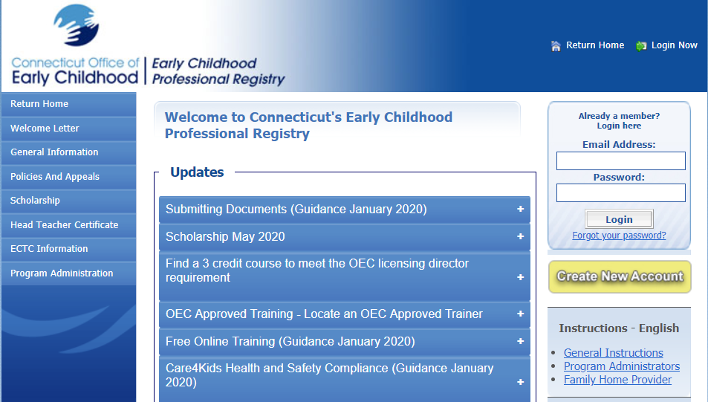
WHERE DO I FIND OTHER CARE PACKAGE SUPPORTS?
For Communications and information about the CTCARES suite of supports:
https://www.ctoec.org/covid-19
Announcements coming about WBDC, Background Check, FA/CPR/MedAdmin
Access Scholarship and Online Training now via your OEC Registry account
www.ccacregistry.org
Notes:
We’ve spoke with so many of you before, during, and since this survey – and all of you wanted to be sure your voices were heard. We can’t thank you enough for your input.

Slide 19

Thank you for all you do for Connecticut’s children!
Remember to explore ALL of the Care Package!
Notes:
This is about the children…thank you for being a child care business – we can’t have a workforce without you!

Slide 20
QUESTIONS?

