Slide 1

Center Based Educator Registered Apprenticeship Program
Pre-Bid Conference
August 28, 2024
Notes:
Opener: lindsay

Slide 2


Welcome
Notes:
Speaker: lindsay
Include introductory or welcome remarks OR quick summary of the RFP right up front (bottom line up front!)

Slide 3
Agenda
Slides | Topic | Speaker(s)
1 - 5 | Opening: Conference Logistics | Lindsay Raymond
6-7 | Welcome & Introductions | Kathleen Hindman
8 - 12 | Program & Strategy Overview | Kathleen Hindman
12-18 | RFP Overview | Kathleen Hindman
24 - 27 | Submission Logistics | Lindsay Raymond
28 - 29 | Evaluation Criteria | Lindsay Raymond
30 - 34 | Anticipated Questions | Kathleen Hindman
35 - 38 | Closing: Key Dates & Reminders | Lindsay Raymond
Notes:
Agenda: lindsay

Slide 4
Disclaimer
This presentation includes brief descriptions of the RFP specifications and requirements but does not fully elaborate on all required elements. As a result, this presentation does not supersede what is stated in the RFP or its appendices. Proposers are responsible for ensuring that their proposal is complete and accurate according to the information and requirements contained in the full RFP.
OEC will respond to submitted questions in writing after the conference. Proposers are responsible for ensuring that they read the official responses, even if their question was verbally answered during the conference.
Notes:
Speaker: lindsay

Slide 5
Logistics of RFP Conference
The OEC will post slides on our website and on the state contracting portal after this conference.
If you are having any technical issues, you may also email oec.rfp.commissioner@ct.gov with your questions instead.
Please type all questions into the question box.
All questions typed in the question box during this conference will be recorded, and responses to questions will be posted in writing on the OEC’s website and the State Contracting Portal after the conference. A recording of this conference and slide deck will be posted as well.
Notes:
Speaker: Cathy

Slide 6
OUR MISSION:
To partner with families of young children to advance equitable early childhood policies, funding and programs; support early learning and development; and strengthen the critical role of all families, providers, educators, and communities throughout a child’s life. We will assertively remove barriers and build upon the strengths of historically disenfranchised people and communities to ensure fair access to OEC resources.
OUR VISION:
All young children in Connecticut are safe, healthy, learning, and thriving. Each child is surrounded by a strong network of nurturing adults who deeply value the importance of the first years of a child’s life and have the skills, knowledge, support, and passion to meet the unique needs of every child.
Notes:
Speaker kathleen

Slide 7


Commitment to Building the Workforce
OEC has addressed the workforce shortage by:
Designing a Family Child Care registered apprenticeship - Cohorts of FCC providers supported by SEIU Education and Support Fund
Funding a workforce pilot program with ARPA and state funds to support centers in developing best practices
Designing a center-based registered apprenticeship with the guidance of industry leaders
Connecting with other states and national partners to maximize the impact of ECE apprenticeship in Connecticut
Notes:
Speaker Kathleen

Slide 8
Program & Strategic Vision
Notes:
Speaker: Kathleen

Slide 9
CBE-RAP Background & Objectives
To help build a robust Early Care and Education (ECE) workforce pipeline, the Office of Early Childhood (OEC) is funding the implementation of a new Center-Based Educator Registered Apprenticeship Program (CBE-RAP), which will:
Provide work-based learning that combines on-the-job training with classroom instruction, a transferrable Child Development Associate (CDA) credential, and a guaranteed wage increase to entry level staff.
Train the employee using a CT DOL-approved, industry created set of standards which includes a portable industry credential upon completion and a minimum standard for training an employee to perform the functions of their job.
Create an opportunity for a person hired by an employer to “earn while they learn”.
See page 4 of the RFP
Notes:
Kathleen

Slide 10
Benefits of the Apprenticeship
While attending class to gain the education needed to become a successful, high-quality early childhood educator, registered apprentices will also serve as early childhood educators in classrooms with the support of more senior staff..
See page 4 of the RFP
Notes:
Speaker: Kathleen
With the proposed apprenticeship structure, the OEC hopes the program will:
• Ensure apprentices enter and remain in the ECE profession through strong apprentice/employer relationships and building the capacity for providers who implement the CBE-RAP to hire and train apprentices.
• Improve the quality of child care available to CT families by supporting increased training for ECE professionals.
• Support an ECE workforce that represents all CT families by providing more professional development opportunities for underrepresented groups, and training more high-quality educators in places where child care is less available.

Slide 11
Opportunity
The RFP will support ECE providers through two pathways:
Pathway A – ECE Providers: The RFP will award funds directly to ECE providers who have the operational capacity to hire, train, and mentor apprentice(s).
Pathway B – Intermediaries: The RFP will award funds to intermediary organizations. Intermediary organizations will be the sponsors of the apprenticeship program on behalf of ECE providers. Intermediaries will provide technical assistance and data collection/reporting support to ECE providers and will support apprentices toward successful completion of their apprenticeship program.
See pages 9 – 10 of the RFP
Notes:
Speaker: Kathleen

Slide 12
Essential Qualifications
Licensed publicly or privately owned child care centers or group homes
For profit or Non-Profit organizations that work with child care centers or group homes
Be in sound fiscal health
  Provide recent budgets, profit and loss for last 3 years
  Pathway A ECE providers must be able to hire apprentices (sound fiscal health) and have staff with experience to be mentors and ability to provide support for reporting and data requirements.
Agree to adhere to the CTDOL requirements of the Appendix A Center Based Educator Registered Apprenticeship Standards
Be registered with the federal system of award management (Sam's Number)
Adhere to Generally accepted accounting principles
See page 7 of the RFP
Notes:
Kathleen
All RFP applicants must be legally registered with CT’s Secretary of State or exempt from such registration per State of CT legislation and provide proof of exemption from registration. Applicants claiming nonprofit status must provide proof of nonprofit status, such as a copy of their Internal Revenue Service (IRS) determination letter.
Be able to provide sufficient staff at the time of award, including managerial and administrative support to implement the required operational and evaluation services and resources to meet CT DOL and OEC data/technology and reporting requirements defined in the Scope of Service Description, found in Section II.D.
• Be in sound fiscal health, as determined by a recent organizational budget. The applicant’s most recent statement of financial activities (profit and loss statement) and documentation of clean opinions in audited financial statements for the last 3 years (or whatever number of years are available, for newer organizations) must be made available if requested.
• Adhere to Generally Accepted Accounting Principles.
• Be registered with System of Award Management (SAM) by the time of contract execution.
• Agree to adhere to the requirements of the Appendix A of the CTDOL Center Based Educator Registered Apprenticeship Standards.

Slide 13
RFP Overview
Notes:
Speaker: Kathleen

Slide 14
Vision For Success
Outreach and Recruitment
  Pathway A ECE Provider
  Pathway B Intermediary
Hiring Apprentices
  W-2 employees
Apprentice Onboarding
  CDA Enrollment
  Class and registry enrollment
  Data Collection
  Job Responsibilities
  CTDOL Agreements & Requirements
See pages 12-13 of the RFP
Notes:
Speaker: Kathleen

Slide 15
Vision For Success
Wrap Around Supports
  Ex: Child care, transportation, tutoring, case management, technology, housing, Language support
Training and Evaluation
  2000 total hours
  Evaluation 3 times throughout the apprenticeship
Provider And Apprenticeship Satisfaction
Wage Increases
Incentive (Bonus) Payments
Completion
Long Term Sustainability
See pages 12-14 of the RFP
Notes:
Speaker: Kathleen

Slide 16

Vision For Success
Organizational Capacity
  Early Care and Education Expertise
  Track Record of Success
  Dedicated Personnel
    Apprentices, Mentor and Program Coordinator
  Diverse Workforce
  Data and Technology
  Data Security, Privacy, and Confidentiality
See pages 15 - 16 of RFP
Notes:
Speaker Kathleen

Slide 17
Financial & Budget Expectations
Program Funding Sources
Total Available Funding & Award Period
Fiscal Health
Financial Management
Bonus Payments
Cost Standards
  Annual administrative costs to 10% of the total budget
$4,275,000
Pathway A
$500,000
Pathway B
$500,000
May apply with one separate proposal submission under each pathway
Minimum allocation for funding for ECE Providers who hire apprentices
Minimum allocation for funding for ECE Providers who hire apprentices
Do not add amounts of multiple proposals or reference other submitted proposals if applying for more than one pathway. Budgets should only be for the proposal submitted for the pathway.
See page 16 of the RFP
Notes:
Speaker: Kathleen
Program Funding Sources: This contract will be funded through a combination of federal American Rescue Plan Act relief funds
Total Available Funding & Award Period: OEC will award up to $4,275,000 in funding over a two-year period. Minimum allocations for funding for each pathway are indicated. The OEC may choose to award any number of high scoring applicants over the minimum funding amount in each category. Award size will vary depending on requested budgets.
Some important factors to consider for respondents includes the following:
Budgets submitted in response to this RFP should reflect anticipated wrap around support and training costs by following the budget template guides. The OEC will work closely with the selected contractor on a regular basis to analyze funding and intermediaries, ECE providers and Apprentices are sufficiently resourced and functioning efficiently, given the available funding.
Cost Standards: Respondents’ budget and planned expenditures for this RFP must comply with the cost standards published by the State of Connecticut Office of Policy and Management. There is an online link provided in the RFP itself to these cost standards.
https://portal.ct.gov/-/media/OPM/POSCostStandards101816pdf.pdf?la=en
As this contracted is primarily funded through federal grants, respondents are also expected to adhere to standards prescribed by the Federal Office of Management and Budget Cost Principles, and a link to these is also provided within the RFP.
https://www.federalregister.gov/agencies/management-and-budget-office
In order to comply with State & Federal requirements, awarded providers must maintain separate accounting/cost centers for State and Federal funding using generally accepted accounting practices. Following award, OEC will reach out to awarded providers about allowable expenditures.
In addition to required compliance with the published cost standards, respondents are advised that a responsive budget must limit annual administrative costs to 10% of the total budget. State or federal funding, by activity, will be determined at point of contracting for final determination of administrative cap.
Per OPM Cost Allocation guidelines, unused/unexpended State funding at the end of the State Fiscal Year (SFY) has to be returned to the State and cannot be carried forward to the following SFY. Federal Funds can be carried forward to the next Federal Budget year with OEC review and approval.

Slide 18
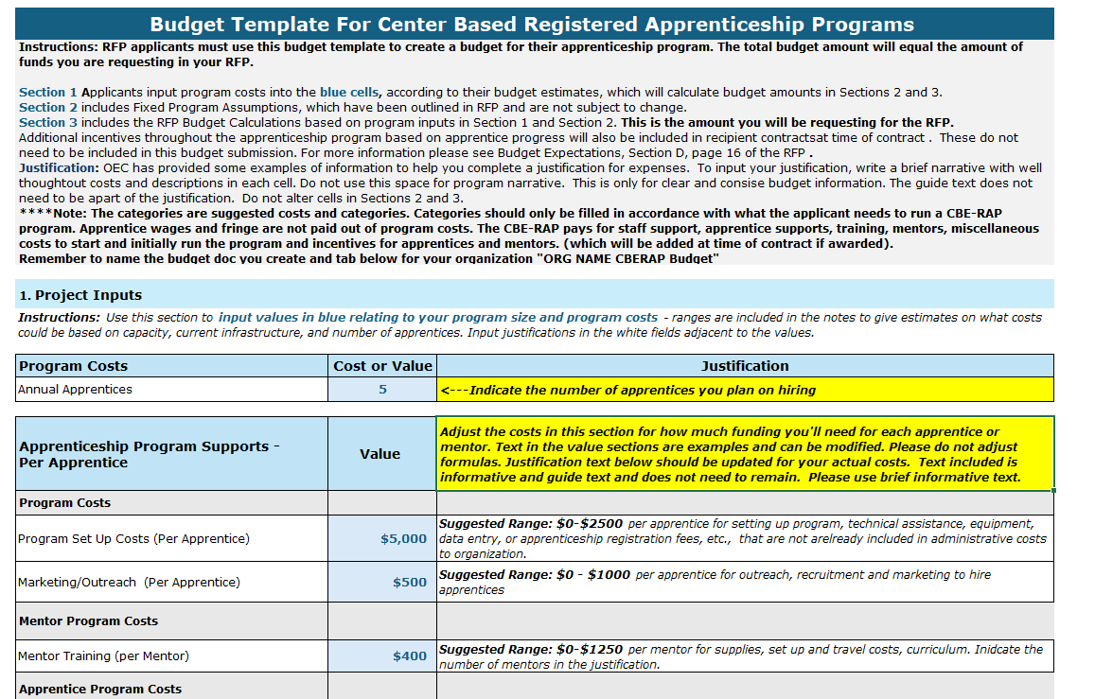
Financial & Budget Expectations
Sample text is to help guide you to fill in budget, justification and staffing costs.
Please do not alter sections 2 and 3 or the formulas in the fillable fields.
Incentive payments are not included.
The budget calculates your annual program costs for you as well as the cost you will submit for the RFP (for 2 years).
See page 16 of the RFP
Notes:
Speaker: Kathleen : (As you read through the bullet points please indicate that This is a screen shot of section one of the budget-- please note that sections 2 & 3 which are not seen -- should not be altered because they help tabulate the total budget amounts. **** Please do not alter the calculations in the fields you enter amounts. )
Program Funding Sources: This contract will be funded through a combination of federal American Rescue Plan Act relief funds
Total Available Funding & Award Period: OEC will award up to $4,275,000 in funding over a two-year period. Minimum allocations for funding for each pathway are indicated. The OEC may choose to award any number of high scoring applicants over the minimum funding amount in each category. Award size will vary depending on requested budgets.
Some important factors to consider for respondents includes the following:
Budgets submitted in response to this RFP should reflect anticipated wrap around support and training costs by following the budget template guides. The OEC will work closely with the selected contractor on a regular basis to analyze funding and intermediaries, ECE providers and Apprentices are sufficiently resourced and functioning efficiently, given the available funding.
Cost Standards: Respondents’ budget and planned expenditures for this RFP must comply with the cost standards published by the State of Connecticut Office of Policy and Management. There is an online link provided in the RFP itself to these cost standards.
https://portal.ct.gov/-/media/OPM/POSCostStandards101816pdf.pdf?la=en
As this contracted is primarily funded through federal grants, respondents are also expected to adhere to standards prescribed by the Federal Office of Management and Budget Cost Principles, and a link to these is also provided within the RFP.
https://www.federalregister.gov/agencies/management-and-budget-office
In order to comply with State & Federal requirements, awarded providers must maintain separate accounting/cost centers for State and Federal funding using generally accepted accounting practices. Following award, OEC will reach out to awarded providers about allowable expenditures.
In addition to required compliance with the published cost standards, respondents are advised that a responsive budget must limit annual administrative costs to 10% of the total budget. State or federal funding, by activity, will be determined at point of contracting for final determination of administrative cap.
Per OPM Cost Allocation guidelines, unused/unexpended State funding at the end of the State Fiscal Year (SFY) has to be returned to the State and cannot be carried forward to the following SFY. Federal Funds can be carried forward to the next Federal Budget year with OEC review and approval.

Slide 19
RFP Logistics
What You Need to Know to Submit a Proposal
Notes:
Speaker: lindsay

Slide 20
Where to Find/Submit Information
The RFP is available on OEC’s website at: https://www.ctoec.org/center-based-educator-registered-apprenticeship/
Information and all documentation are also available on the State Contracting Portal
  Go to the CT Source Bid Board and Search for Solicitation # OEC-24-CBERAP
  Note: Register at the state portal and subscribe to this RFP; you will receive email updates when new documents are added
All questions/communications, LOIs, and the final proposal should be emailed to oec.rfp.commissioner@ct.gov
Notes:
Speaker: lindsay
This slide is guiding you to the areas where you can find all the associated RFP documentation:
Information and all documentation are available in electronic format on the State Contracting Portal
Go to the web procurement site as shown here: https://webprocure.perfect.com/wp-web-public/#/bidboard/bid/92439?customerid=51
Note: Once you register at the state portal and subscribe to this RFP; you will receive email updates when new documents are added or
Also available on the OEC’s website at the link shown here: https://www.ctoec.org/rfps/sfccn-rfp/
All questions/communications, LOIs, and the final proposal should be emailed to oec.rfp.eceqi@ct.gov

Slide 21
Submission & Formatting Requirements
Cover Sheet (Page 1)
Table of Contents
Executive Summary
Required Attachments
10-page limit for main body of the proposal
8.5 x 11 page size
12-point, Times New Roman font
Normal margins
1.5 line spacing
We are not judging how visually “beautiful” your proposal is, but a readable document that is simple to navigate makes it easier for us to focus on the substance of your proposal!
Reminders:
Include page numbers and label each attachment
Make sure any scanned attachment is legible
Budgets should be submitted in their original spreadsheet format from the template provided by OEC
Before you submit your proposal, ask yourself:
  If I was reading through this proposal, would it be easy for me to find the information I’m looking for?
  Do I have to strain my eyes or rotate the document multiple times before I can read the content?
See page 23 of the RFP
Notes:
Speaker: lindsay
We are not judging how visually “beautiful” your proposal is, but a readable document that is simple to navigate makes it easier for us to focus on the substance of your proposal! We’ve listed here some of the key components you will want to be sure to include within your proposal.
Cover sheet 1st page of proposal. It needs to include the following: RFP Name or Number
Legal Name
FEIN
Street Address
Town/City/State/Zip
Contact Person
Title
Phone Number
E-Mail Address
Authorized Official
Title
Signature
Table of Contents. All proposals must include a Table of Contents that conforms with the required proposal outline.
Executive Summary. Proposals must include a high-level summary, not exceeding 1 page, of the main proposal
Attachments. Attachments other than the required Appendices or Forms identified in the RFP are not permitted and will not be evaluated. Further, the required Appendices or Forms must not be altered or used to extend, enhance, or replace any component required by this RFP. Failure to abide by these instructions will result in disqualification.
Style Requirements. Submitted proposals must conform to the following specifications:
Paper Size: 8 ½ x 11 (Letter)
Page Limit: Maximum 10 pages for the main body of the proposal (the cover letter, executive summary, budget, and required attachments do not count towards this 10 page limit)
Font Size: 12
Font Type: Times New Roman
Margins: Normal (1 inch)
Line Spacing: 1 ½
Pagination. The proposer’s name must be displayed in the header of each page. All pages, including the required Appendices and Forms, must be numbered in the footer.
Declaration of Confidential Information. Proposers are advised that all materials associated with this procurement are subject to the terms of the Freedom of Information Act (FOIA), the Privacy Act, and all rules, regulations and interpretations resulting from them. If a proposer deems that certain information required by this RFP is confidential, the proposer must label such information as CONFIDENTIAL prior to submission.

Slide 22
Writing the RFP Proposal
Vision for Success –identifies key components of CBE-RAP requirements to be successful as an employer of an apprentice. (pages 11-16 of the RFP)
Main Proposal Prompts- provides an outline for the main proposal and prompts and questions for the applicants. (pages 24-25 of the RFP)
Evaluation Criteria and Weights- identifies the weights for each scoring section and components of a high score. (pages 20-22 of the RFP)
CTDOL Appendix A- is the guide for the program and contains required information for applicants to understand how the employer should construct their apprenticeship (CBE-RAP) program. (separate document)
Notes:
Speaker: Lindsay
This slide is designed to help clarify the helping sections of the RFP and how they interact to help the applicant to draft a successful proposal in 10 pages. The Vision for Success and the Evaluation table helps to put together a thoughtful, clear and succinct proposal in 10 pages. lindsay should mention --How do these sections support and work with the Appendix A of the CT DOL Standards guide for the apprentice ship.

Slide 23
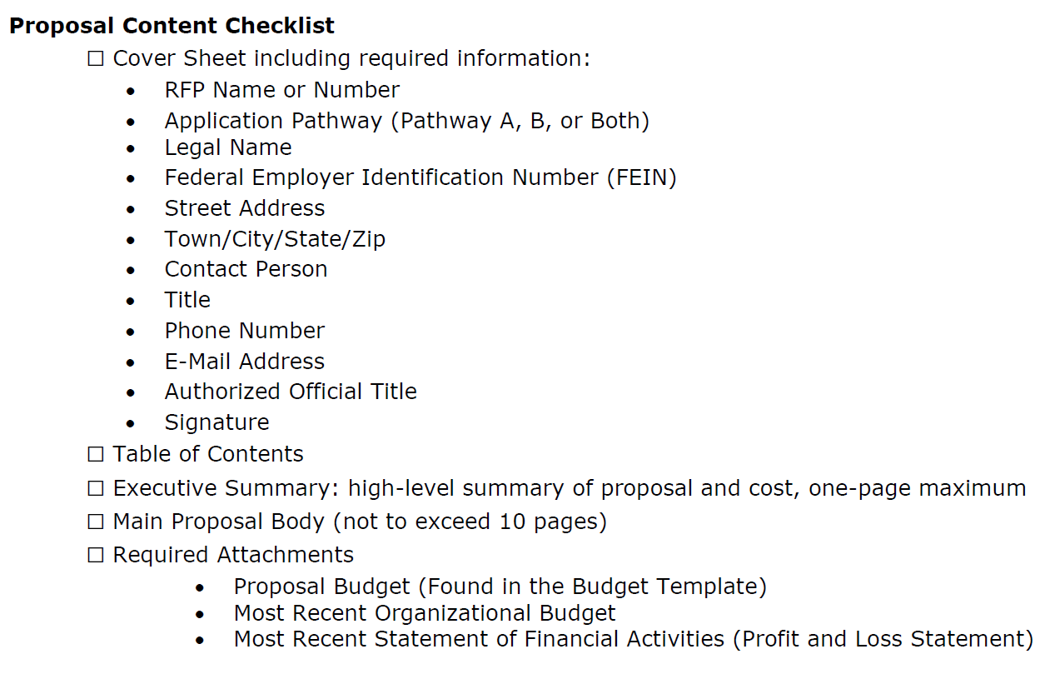
Proposal Checklist
This is a tool to help you put together your proposal.
See pages 36 – 37 of the RFP
Notes:
Speaker: Lindsay
This slide is showing a helpful checklist tool that we encourage you to use while completing your proposal. It can be found on pages 36-37 of the RFP document.

Slide 24
Evaluation Criteria
How We’ll be Scoring Proposals
Notes:
Speaker: lindsay

Slide 25
Evaluation Criteria
Evaluation Criterion Title | Weight
Program Overview | Required for application review
Organizational Structure | 30%
Financial Health | 10%
Program Proposal | 50%
IT, Data and Performance Management | 10%
Bonus | 5 pts
See pages 20 - 22 of the RFP
Notes:
Speaker: lindsay --- Vision for success spells out clearly, ideal candidates have …. And the prompt section of the RFP to help applicants draft their proposal. Highlight the program overview and program attestation; bonus question.

Slide 26

Questions
& Key Items to Keep In Mind
Notes:
Speaker: Kathleen

Slide 27
Does the RFP funding fund wages of Apprentices?
No. The selected applicant must hire apprentices as W-2 employees. The RFP does pay for workforce supports for training, education and assistance to the business for subs during that apprentice training, transportation for apprentices, bonuses, basic needs supports for the apprentice while completing CDA courses, and even mentors (from existing staff) for the apprentice.
Notes:
Speaker: Kathleen

Slide 28
Can current staff become apprentices?
Yes. If the staff was an intern or a 1099 employee, the center would have to hire them as a W-2 staff member. Ideally, funding for recruitment and marketing of the opportunity is provided because the funding is intended to recruit new staff or to assist the ECE provider to be able to hire full time staff. The funding provides the supports and bonuses to retain the staff.
Notes:
Speaker: Kathleen

Slide 29
Can an intermediary organization apply as a provider if the intermediary also has a licensed center or group home?
Yes. The applicant would need to submit a separate budget and proposal for Pathway A and Pathway B. The submissions may use duplicate attachments (i.e., nonprofit letters etc.) however, each of the required documents must accompany each submission. The submissions are separate, must be complete according to the requirements of submission and can not reference any other submission.
Notes:
Speaker: Kathleen

Slide 30
Do the verifications for the Bonus Question count in the 10-page proposal limit?
No. To respond to the Bonus question, applicants may provide documentation (no more than three pages) to verify the enrollment of children at their business in publicly funded programs. These pages would be a separate attachment with a summary that briefly describes the documentation provided. The attachment does not count towards the 10-page proposal limit.
Notes:
Speaker: kathleen

Slide 31
What happens to the Apprentice after they receive their credentials and training? ​
Ideally, the apprentice will remain at the licensed center or group home that employed them throughout their apprenticeship. The apprenticeship program is designed to help providers grow their workforce by supplying the training and supports young professionals need to enter and remain in the workforce. The employer, by hiring the apprentice and enrolling in the CBE-RAP, hopefully will develop loyal, quality employees who can help grow the enrollment at the center and raise the quality of services provided. In partnering to kick start employment, with the State providing supports and education and with the outlay of wages by the Center, together, the state and businesses can attract young professionals to the field to meet the needs of families and children around the state.
Notes:
Speaker: kathleen

Slide 32
OEC
Key Dates and Reminders
Notes:
Speaker: lindsay

Slide 33

Timelines
For RFP Submission:
August 30, 2024
5:00 p.m. ET
September 13, 2024
5:00 p.m. ET
October 4, 2024
5:00 p.m. ET
Letters of Intent Due (Optional)
Deadline for questions
Proposals due
For RFP Questions:
Tuesdays (August 27, September 3, 10, 17)
September 17, 2024
Answers to questions will be posted
Amendments to the RFP will be finalized
Notes:
Speaker: lindsay

Slide 34

Contact Information
    Office of Early Childhood Website
    https://www.ctoec.org/center-based-educator-registered-apprenticeship/
Official Contact
RFP information
Lindsay Raymond
Office of Early Childhood
E-mail: OEC.RFP.commissioner@ct.gov
Telephone: (860) 500 – 4579
Mail: 450 Columbus Boulevard
Hartford, Connecticut 06103
    State Contracting Portal
    https://portal.ct.gov/DAS/CTSource/BidBoard
All RFP inquiries must be made in writing. The slide deck from today's conference will be posted on OEC website.
For more information, see page 5 of the RFP
Notes:
Speaker: lindsay

Slide 35
THANK
YOU!
Notes:
Lindsay to thank everyone and encourage them to apply

